Slide 1
Developing Cloud Applications with Microsoft Azure
By Muhammad Muneeb Ullah Khan

Slide 2
what is cloud computing?
cloud computing is the delivery of computing services—including servers, storage, databases, networking, software, analytics, and intelligence—over the Internet (“the cloud”) to offer faster innovation, flexible resources, and economies of scale.

Slide 3
Cloud service models
IaaS (Infrastructure As A Service)
PaaS (Platform As A Service)
SaaS (Software As A Service)

Slide 4
IaaS (Infrastructure As A Service)
IaaS, or Infrastructure as a Service, is a cloud computing model that provides on-demand access to computing resources such as servers, storage and virtualization. IaaS is also known as Hardware as a Service (HaaS).
Examples of IaaS are Amazon Web Services, Microsoft Azure, IBM Cloud etc.

Slide 5
PaaS (Platform As A Service)
PaaS, or platform as a service, is on-demand access to a complete, ready-to-use, cloud-hosted platform for developing, running, maintaining and managing applications. PaaS provides a framework that developers can build upon to develop or customize cloud-based applications. PaaS lets developers create applications using built-in software components.
Examples of PaaS are Microsoft Azure, IBM Cloud, Google App Engine etc.

Slide 6
SaaS (Software As A Service)
Software as a Service or SaaS is a way of delivering applications over the Internet – as a service. Also known as cloud software, ASP, on-demand software or hosted software. SaaS is also known as "On-Demand Software". It is a software distribution model in which services are hosted by a cloud service provider. These services are available to end-users over the internet so, the end-users do not need to install any software on their devices to access these services.
Examples of SaaS are Gmail, Microsoft etc.

Slide 7
Microsoft azure cloud services
Azure is Microsoft’s cloud platform, just like Google has its Google Cloud and Amazon has its Amazon Web Service or AWS.000. Generally, it is a platform through which we can use Microsoft’s resources. For example, to set up a huge server, we will require huge investment, effort, physical space, and so on. In such situations, Microsoft Azure comes to our rescue. It will provide us with virtual machines, fast processing of data, analytical and monitoring tools, and so on to make our work simpler. Azure is also commonly used as a platform for hosting databases in the cloud. Microsoft offers serverless relational databases such as Azure SQL and non-relational databases such as NoSQL. In addition, the platform is frequently used for backup and disaster recovery.

Slide 8
Azure cloud services list
Some of Azure Cloud Service List includes:
Azure Active Directory
Azure SQL Database
Azure Virtual Machine
Visual Studio Code
Azure App Service
Azure DevOps

Slide 9
Azure Active Directory
Azure Active Directory (Azure AD) is a cloud-based identity and access management service. Azure AD enables your employees access external resources, such as Microsoft 365, the Azure portal, and thousands of other SaaS applications.
All employees in an organization need access to some Azure services to perform their tasks. They can access services like SQL database, machine learning, or Azure container services when the administrator assigns them separate user id and password for each service. Employees, as well as administrators, often find it hard to manage multiple user logins at the same time. It creates more of a hassle for administrators working in an organization that involves more than 1000 employees.
This is where Azure Active Directory (AD) comes into the picture. With Azure AD, the administrators can handle multiple user logins without any issue. Administrators need to assign a single username and password to access all the services they want.

Slide 10
Who uses azure ad?
There are three types of audiences in Azure active directory:
IT administrators
Application developers
Online customers

Slide 11
IT administrators
IT administrators take care of all the sign-in procedures. They also solve issues related to authentication.
IT admins use Azure AD to control access to apps and app resources, based on business requirements. For example, as an IT admin, you can use Azure AD to require multi-factor authentication when accessing important organizational resources.

Slide 12
Application developers
Application developers use these services to build applications. Development becomes quick since there are many resources available.
App developers can use Azure AD as a standards-based authentication provider that helps them add single sign-on (SSO) to apps that works with a user's existing credentials.

Slide 13
Online customers
They make use of services like Office 365, CRM services, and have all their demands catered immediately.
Microsoft 365, Office 365, Azure, or Dynamics CRM Online subscribers already use Azure AD as every Microsoft 365, Office 365, Azure, and Dynamics CRM Online tenant is automatically an Azure AD tenant. You can immediately start managing access to your integrated cloud apps.

Slide 14
Azure SQL Database
Microsoft Azure SQL Database is a relational database-as-a-service that is reliable and secure, and it gives high performance without having to worry about any infrastructure.
Azure SQL is a relational database platform that is present in the cloud where users can host the data and use it as a service. You can pay for what you have used, like all other cloud services. Azure SQL is built based on the SQL Server.

Slide 15
Azure SQL vs sql server
AZURE SQL DATABASE | SQL SERVER DATABASE
One database can host several databases from different customers. | Databases are the only objects on the server.
It is easy to use as you do not need any physical hardware. | Working with a physical system is tiring.
It involves automatic backup. | It involves manual scheduling of backup.

Slide 16
Azure Virtual Machine
A virtual machine is a computer file, that behaves like an actual computer. It can run in a window as a separate computing environment, often to run a different operating system
Azure virtual machines are one of several types of on-demand, scalable computing resources that Azure offers. An Azure virtual machine gives you the flexibility of virtualization without having to buy and maintain the physical hardware that runs it. However, you still need to maintain the virtual machine by performing tasks, such as configuring, patching, and installing the software that runs on it.

Slide 17
Visual Studio Code
A powerful, lightweight free code editor with integrated tools to easily deploy your code to Azure.

Slide 18
Azure App Service
Azure App Service enables you to build and host web apps, mobile back ends, in the programming language of your choice without managing infrastructure. Azure Web Apps provides a fully managed platform for building and hosting web applications using popular programming languages such as . NET, Java, Node, Python, and PHP. Azure App Service is a fully managed platform as a service (PaaS) offering for developers.

Slide 19
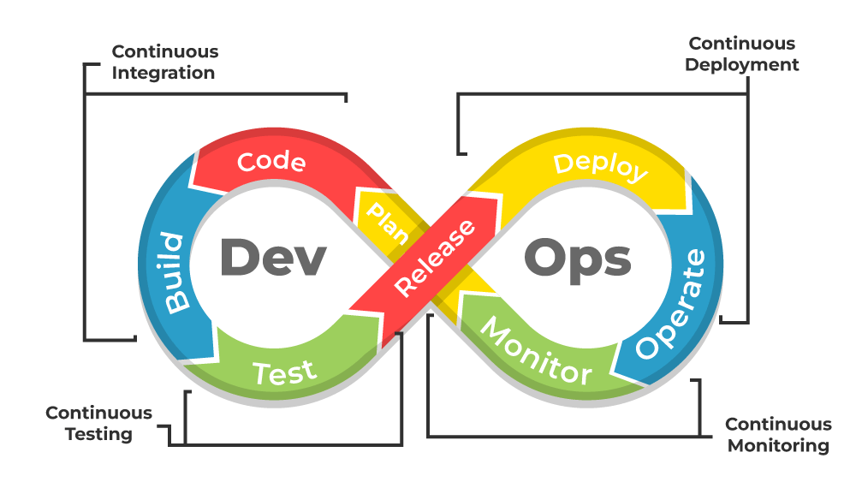
Azure DevOps
DevOps is a combination of software development (dev) and operations (ops). DevOps is a software development approach emphasizing collaboration, automation, and continuous delivery to provide high-quality products to customers quickly and efficiently.

Slide 20
Azure DevOps
Azure DevOps is a software as a service (SaaS) platform from Microsoft designed to provide a comprehensive toolchain for developing and deploying software projects.
Azure DevOps is an end-to-end software development platform that offers an assortment of capabilities intended to organize and accelerate development efforts across the entire application lifecycle.
Azure DevOps supports a collaborative culture and set of processes that bring together developers, project managers, and contributors to develop software. It allows organizations to create and improve products at a faster pace than they can with traditional software development approaches.

Slide 21
Entity framework
Entity framework is an Object Relational Mapping (ORM) framework that gives developers an automated way to store and access databases. The Entity Framework Core tools help with design-time development tasks. They're primarily used to manage Migrations and to scaffold a DbContext and entity types by reverse engineering the schema of a database.

Slide 22
What is LINQ?
Language-Integrated Query (LINQ) is a powerful set of technologies based on the integration of query capabilities directly into the C# language. LINQ Queries are the first-class language construct in C# .NET, just like classes, methods, events.
For example, SQL is a Structured Query Language used to save and retrieve data from a database. In the same way, LINQ is a structured query syntax built in C# and VB.NET to retrieve data from different types of data sources such as collections, ADO.Net, DataSet, XML Docs, web service and MS SQL Server and other databases.

Slide 23
Cloud environments
There are 3 types of cloud environments:
Public clouds.
Private clouds.
Hybrid clouds.

Slide 24
Public clouds.
The public cloud refers to the cloud computing model in which IT services are delivered via the internet. As the most popular model of cloud computing services, the public cloud offers vast choices in terms of solutions and computing resources to address the growing needs of organizations of all sizes and verticals.

Slide 25
Private clouds.
The private cloud refers to any cloud solution dedicated for use by a single organization. In the private cloud, you’re not sharing cloud computing resources with any other organization. Private cloud is customizable to meet the unique business and security needs of the organization. With greater visibility and control into the infrastructure, organizations can operate compliance-sensitive IT workloads without compromising on the security and performance previously only achieved with dedicated on-premise data centers.

Slide 26
Hybrid clouds.
The hybrid cloud is any cloud infrastructure environment that combines both public and private cloud solutions. Organizations can use private cloud environments for their IT workloads and complement the infrastructure with public cloud resources to accommodate occasional spikes in network traffic.

Slide 27
Azure security features
Azure Cloud security, also known as cloud computing security, is a collection of security measures designed to protect cloud-based infrastructure, applications, and data. These measures ensure user and device authentication, data and resource access control, and data privacy protection. Some of the Azure security features are given as following:
Network Security
Microsoft Defender for Cloud
Malware Protection
Access Management
Authentication
Authorization

Slide 28
Network Security
Protect your applications and cloud workloads from network-based cyberattacks with network security services. Azure Firewall is a cloud-native and intelligent network firewall security service that provides threat protection for your cloud workloads running in Azure.

Slide 29
Microsoft Defender for Cloud
Microsoft Defender for Cloud is a cloud-native application protection platform (CNAPP) with a set of security measures and practices designed to protect cloud-based applications from various cyber threats and vulnerabilities.

Slide 30
Malware Protection
Microsoft Antimalware for Azure is a free real-time protection that helps identify and remove viruses, spyware, and other malicious software. It generates alerts when known malicious or unwanted software tries to install itself or run on your Azure systems. Use Microsoft Antimalware for Azure Cloud Services and Virtual Machines to continuously monitor and defend your resources.

Slide 31
Access Management
Protect your applications and data at the front gate with Azure identity and access management solutions. Defend against malicious login attempts and safeguard credentials with risk-based access controls, identity protection tools, and strong authentication options.

Slide 32
Authentication
The process of verifying the identity of a user or app that accesses the API. Authentication may be done through credentials such as username and password.
Authentication is a process that verifies that someone or something is who they say they are. Technology systems typically use some form of authentication to secure access to an application or its data. For example, when you need to access an online site or service, you usually have to enter your username and password. Then, behind the scenes, it compares the username and password you entered with a record it has on its database. If the information you submitted matches, the system assumes you are a valid user and grants you access.

Slide 33
Authorization
The process of determining whether a user or app has permission to access a particular API, often through a token-based protocol.
Authorization is the security process that determines a user or service's level of access. In technology, we use authorization to give users or services permission to access some data or perform a particular action. If we revisit our coffee shop example, Rahul and Lucia have different roles in the coffee shop. As Rahul is a barista, he may only place and view orders. Lucia, on the other hand, in her role as manager, may also have access to the daily sales totals. Since Rahul and Lucia have different jobs in the coffee shop, the system would use their verified identity to provide each user with individual permissions. It is vital to note the difference here between authentication and authorization. Authentication verifies the user (Lucia) before allowing them access, and authorization determines what they can do once the system has granted them access (view sales information).

Slide 34
Web API
API stands for Application Programming Interface.
A Web API is an application programming interface for the Web.
API is short for Application Programming Interface and is a software mediator that allows two or more applications to talk to each other. Every time you send a message to your friend over the internet or check the weather on your phone, you use API without knowing it.

